Slide 1
Amundi Funds Protect 90
Protected diversified investment Share Class A2 EUR (C)
June 2024
Document for professional investors only – Marketing communication

Slide 2
Amundi Funds Protect 90
In short
Why now? | In an environment of low real rates, investors may need to take risks to achieve inflation-adjusted returns on their savings Economic, financial and political uncertainty can make risk taking nowadays challenging Amundi Funds Protect 90 belongs to a new generation of protected investments which seeks to adapt to many market conditions with the double objective of seeking performance and partially protecting savings¹
Why this fund? | To reconcile what we consider to be two of the main expectations of investors: A search for performance with an active and flexible investment strategy within a wide and diversified² investment universe A permanent partial capital protection³, explicitly guaranteed (by Amundi SA, the “Guarantor”) (A+ Fitch Ratings)
Why Amundi? | The fund brings together the expertise of two well-established and highly experienced teams within Amundi: multi-asset and structured solutions A long and proven track-record of the strategy⁴ A successful worldwide distribution of the strategy
Source Amundi as at 28 June 2024. 1. The Fund does not offer a performance guarantee. 2. Diversification does not guarantee a profit or protect against a loss. Given for information purposes only. 3. Please see the Prospectus for complete information on the investment policy, objectives and strategy of the Fund. 4. Inception of the strategy in 2008. Please note opinions, estimates, views, forecasts, projections and statements of financial market trends are based on market conditions at the date of the publication, constitute our judgment and are subject to change without prior notice. There can be no guarantee they will be met.

Slide 3
Contents
Why now?
Why Amundi Funds Protect 90?
Why Amundi?
Performances and positioning

Slide 4
In a complex and uncertain environment
Low real interest rates
Political, economic and financial uncertainty
Low inflation-adjusted remuneration on lowest-risk assets
An environment that may pose a challenge to all risk-taking decisions
Amundi offers a new generation of partially protected investments :
Amundi Funds Protect 90
A protected investment means adapting to market conditions with the double objective of seeking performance¹ and partially protecting savings².
Source Amundi as at 28 June 2024. For illustrative purposes only, may be subject to change without prior notice. 1. The Fund does not offer a performance guarantee. 2. The Fund aims to provide a permanent partial protection of capital invested over the recommended holding period. Please see the Prospectus for complete information on the investment policy, objectives and strategy of the fund.

Slide 5
A new generation of protected investment
Seeking to reconcile what we consider to be two of the main expectations of investors
Search for performance¹
Permanent partial capital protection²
Amundi Funds Protect 90 seeks a moderate capital growth through an actively managed portfolio based on fundamental market analysis and investment with convictions, with an explicit permanent partial capital protection over the recommended holding period. Our goal is to maximize the performance of the portfolio within a risk limit².
Source Amundi as at 28 June 2024. 1. The Fund does not offer a performance guarantee. 2. Please see the Prospectus for complete information on the investment policy, objectives and strategy of the Fund. The Fund benefits from a daily protection representing 90% of the highest NAV (Net Asset Value) recorded from the last business day of the preceding month of April regardless of the subscription date.

Slide 6
Contents
Why now?
Why Amundi Funds Protect 90?
Why Amundi?
Performances and positioning

Slide 7
SFDR // Everything you need to know
A DEFINITION
THE BENEFITS FOR INVESTORS
The Sustainable Finance Disclosure Regulation is an EU regulation that applies from 10 March 2021.
SFDR aims to assist investors by:
Enabling better informed investment decisions through improved disclosures
Providing more transparency to better facilitate product comparison
Disclosing if and how ESG risks are integrated into investment decisions
Identifying products that are not ESG
Preventing greenwashing
THE REQUIREMENTS
Financial Market Participants and Financial Advisers must provide ESG-related information on their financial products.
WHY IT MATTERS
Aims to increase transparency in responsible investing and enable investors to make informed investment decisions based on ESG factors.
HOW DOES IT WORK
WHY AMUNDI?
Products are mapped in 3 categories (“Article 9”, “Article 8” and “Article 6”) based on the ESG criteria that are applied to the investment process.
100% of Amundi’s open-ended funds now include an Environmental, Social and Governance analysis of the companies in which it invests¹
Source : Amundi, as of 28 June 2024. The decision of the investor to invest in the fund should take into account all the characteristics or objectives of the fund. For more product-specific information, please refer to the Prospectus and the Pre-contractual document (PCD)

Slide 8
CORE esg // This Fund is classified SFDR Article 8
✓ ESG criteria integrated into the investment process we vet our investments and look at companies that follow Environmental, Social and Governance principles (ESG) to help contribute to a better future. ✓ ESG score above the fund benchmark we aim to achieve higher ESG scores than the benchmark (or investment universe where there is none). ✓ ESG risks are taken into account we clearly disclose if and how these risks are considered when making investment decisions. ✓ ESG RATING SYSTEMS we have our own ESG rating system to measure the ESG performance of an issuer. We look at how they manage and anticipate any relevant ESG risks and opportunities.
An Overview of SFDR Categories
MIN
Minimal or no ESG criteria applied
ARTICLE
6
ARTICLE
8
ARTICLE
9
MAX
ESG is at the
core of the
product
No ESG
criteria
Basic ESG criteria (risk integration)
Sustainable Investment Objective
Promote ESG characteristics
The decision of the investor to invest in the fund should take into account all the characteristics or objectives of the fund. For further details please see the Pre-Contractual Annex. Please refer to the Amundi Responsible Investment Policy and the Amundi ESG Regulatory Statement. For more product-specific information, please refer to the Prospectus

Slide 9
The key points of Amundi Funds Protect 90
The objective of Amundi Funds Protect 90 is to participate in the evolution of the financial markets with a permanent partial capital protection¹.
Search for performance²
Permanent partial
capital protection¹
Multi-asset: a broad and diversified investment universe
An active and flexible management based on fundamental market analysis and investment convictions
A protection equal to 90% of the highest net asset value recorded since the last business day of the preceding month of April (annual reset)
A formal guarantee granted by the Guarantor (A+ Fitch Ratings)
Risk Profile : SRI 3
Availability
Simplicity
Savings available at all times
We seek to provide investors with an understandable message
Source: Amundi Asset Management as of 28 June 2024. 1. For more product-specific information and information on the investment policy, strategy and objectives of the Fund, please refer to the Prospectus. 2. The Fund does not offer a performance guarantee. The SRI corresponds to the risk/reward profile shown in the PRIPS KID. The lowest category does not imply that there is no risk. The SRI is not guaranteed and may vary over time.

Slide 10
Search for performance
A broad and diversified investment universe¹
Try to take advantage of all opportunities for performance on the markets
All asset classes
All geographic regions and sectors
All types of instruments
An active and flexible investment strategy
To constantly adapt to different market situations
In case of favourable market conditions, the sub-fund seeks to prioritises risky assets¹ to capture their performance potential²
Preferred asset classes
Equities, bonds
Risky assets
Equities
Bonds
Money market
In case of bear or uncertain markets, the portfolio’s level of risk is reduced and the sub-fund shifts towards less risky assets¹
Preferred asset classes
Bonds, money market
Risky assets
Risky assets
Source: Amundi Asset Management as of 28 June 2024. 1. The Fund invests in all types of asset classes, allocating between a growth component (diversified higher risk investments) and a conservative component (lower risk investments). For more product-specific information, please refer to the Prospectus 2. The Fund does not offer a performance guarantee.

Slide 11
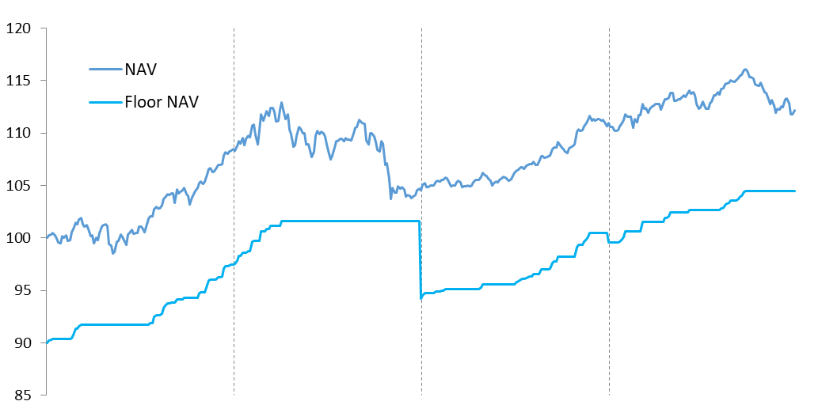
Partial and permanent capital protection¹
90% of the highest NAV recorded since the last business day of the preceding month of April
At the start of every annual period Y (1 May – 30 April), the Floor NAV is recalculated as 90% of the NAV of the last business day of the previous annual period (Y-1).
The Floor NAV increases each time the sub-fund’s NAV reaches a new high point during the annual period
Protection reset
Y1
Y2
Y3
Y4
If the NAV decreases during the period, the Floor NAV remains equal to 90% of the highest NAV since the last day of the preceding annual period
Entry point
NAV = EUR 100
Floor NAV = EUR 90
Exit point
NAV = EUR 111.8
Floor NAV = EUR 105.50
Source: Amundi Asset Management as of 28 June 2024. Graph provided for illustrative purposes only. It serves in no way as an indication of the future performance of Amundi Funds Protect 90 or a guarantee of future returns. 1. The Fund aims to provide a permanent partial protection of capital invested over the recommended holding period. Please see the Prospectus for complete information on the investment policy, objectives and strategy of the Fund.

Slide 12
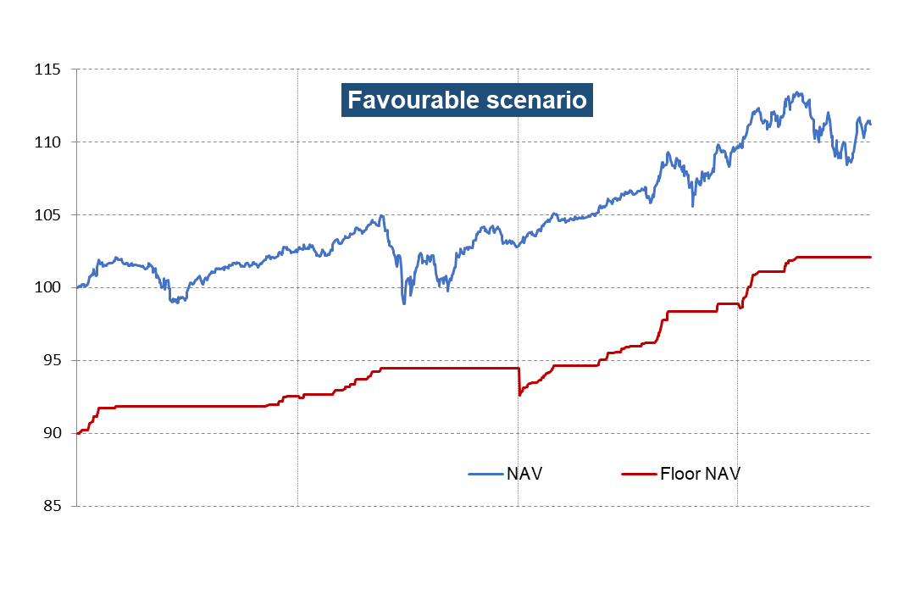
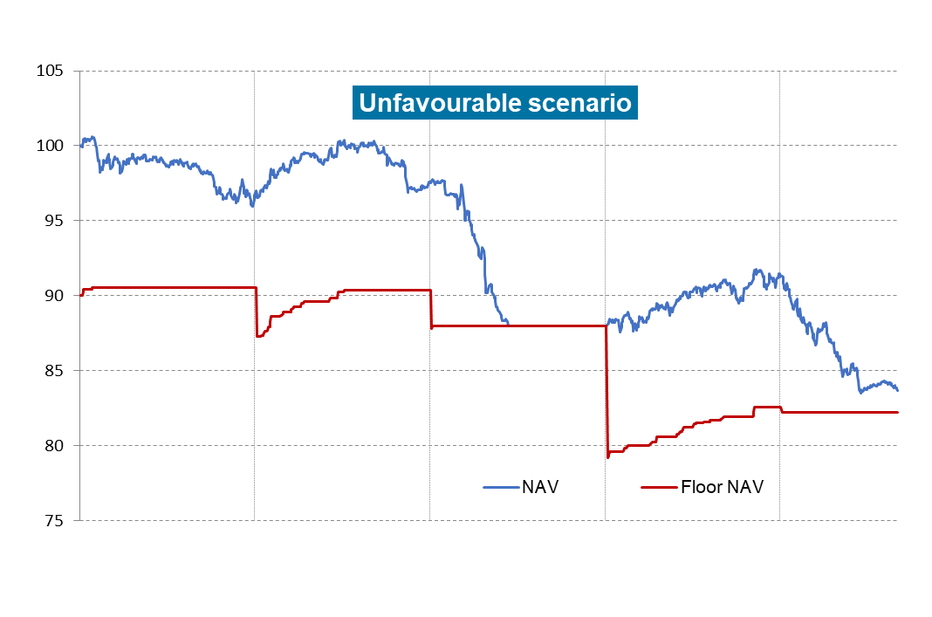
The sub-fund’s behaviour depending on the markets
In the event of a favourable market trend
The trend of the net asset value is linked to the markets.
Investors can benefit from the increased level of protection of the sub-fund’s net asset value and of the partial and progressive lock-in of sub-fund performances.
However, should risky assets¹ rise, the mechanism for ensuring such protection may limit the sub-fund’s ability to gain from this rise².
In the event of an unfavourable market trend
If the net asset value experiences a decline, which may lead in case of significant and/or persistent bear markets to full money market investment, the sub-fund may no longer take advantage of the performance potential of the dynamic assets² until the next reset date (next 1st business day of May).
Source: Amundi Asset Management as of 28 June 2024. Graphs provided for illustrative purposes only, may be subject to change without prior notice. They do not serve to act as an indicator of future performance of the Fund. 1. The Sub-Fund invests in all types of asset classes, allocating between a growth component (diversified higher risk investments) and a conservative component (lower risk investments). For more product-specific information on the investment policy, strategy and objectives of the Fund, please refer to the Prospectus. 2. The Sub-Fund does not offer a performance guarantee.

Slide 13
Contents
Why now?
Why Amundi Funds Protect 90?
Why Amundi?
Performances and positioning

Slide 14
A strategy which brings together the expertise of two well-established and experienced teams
Multi-asset
Structured solutions
Flexible protected asset management¹
Multi-asset expertise
€ 265 bn in assets under management
200+ experts leveraging Amundi’s full breadth of expertise
13 countries - Global investor with local presence in Europe, Asia & North America
+35-year experience in multi-asset solutions
Global leading platform
Structured Solutions expertise
€86 bn in assets under management
50+ investment professionals
More than 30 years of global expertise
Leader in France
N°1 in inflows* on the structured products segment
A leading actor in Europe
Clients
Retail networks, third party distribution, institutions
Source: Amundi & Broadbridge as of 31/12/2023 - * Source : Structured Retail Products & Amundi, year 2023 (funds and notes).

Slide 15
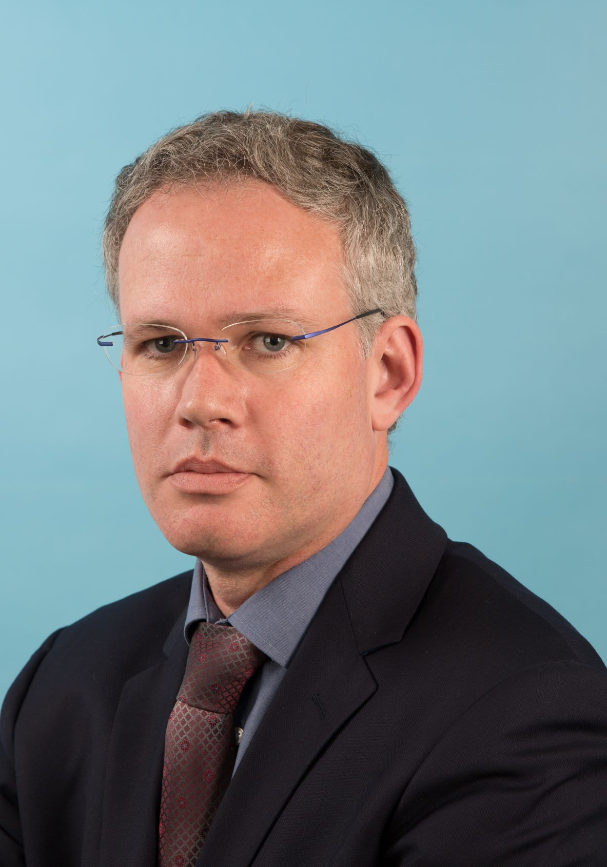
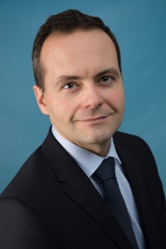
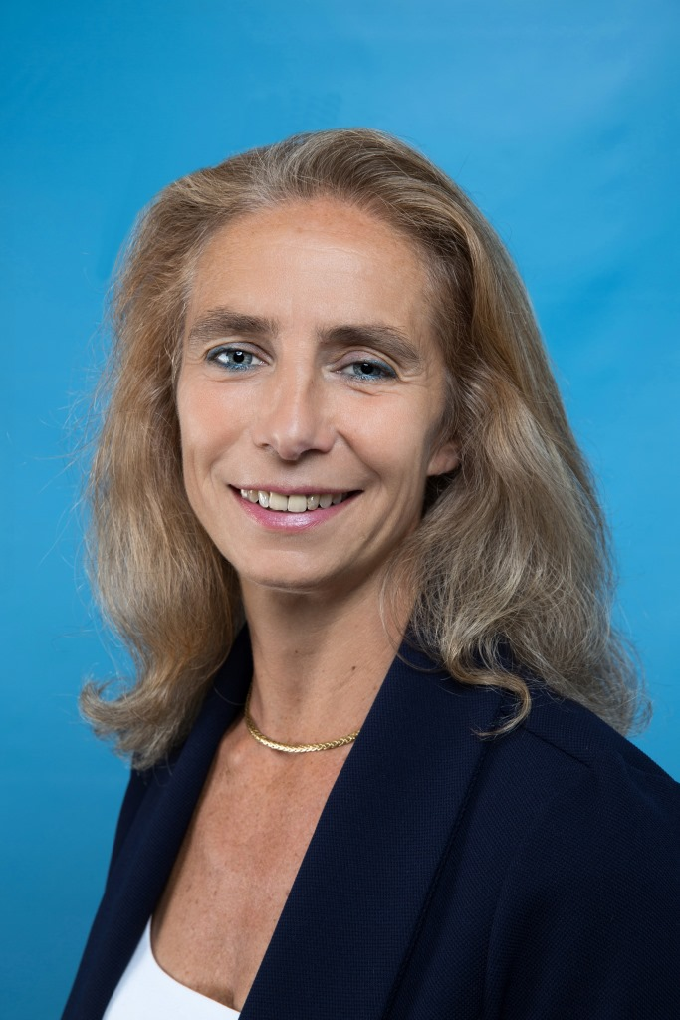
An experienced and stable management team
 | Mickaël Levier – Head of Hybrid Structured Fund Management Since 2012, Mickaël has been head of the Hybrid Structured Fund Management team, managing multi-asset and equity guaranteed funds (mainly portfolio insurance funds). He joined the Hybrid Structured Fund Management team in 2007 as Portfolio Manager and previously Amundi in 2005 as Information Technology project manager. He started his career in 2002 at Cadextan, an IT services company, where he developed front office tools for Credit Lyonnais Asset Management.. Mickaël holds a master’s degree from the French engineering school “Supélec”.
 | Alain Baron, CFA, CAIA - Multi-Asset Portfolio Manager Alain joined the multi-asset management team in 2005. He is more specifically in charge of managing target risk funds for retail clients. Alain joined the Crédit Agricole Group in 1998 as a member of ALM department. From 2001 to 2005, he held a Risk Controller position at Credit Agricole Asset Management. He holds a Masters in Finance from ESSEC (1997) and a Masters in Financial Mathematics from the University Paris I, Sorbonne (1996). CFA, 2005. CAIA, 2009
 | Isabelle de Malherbe - Head of Product Specialists - Structured Solutions Isabelle started her career in 1989 in the Interest Rate Derivatives department of Credit Lyonnais covering various positions: quantitative research and development in Paris and New-York then from 1995, structuring and sales in Paris. In 2000 she moved to the Equity Capital Markets team. From 2005, she has been part of the Structuring and Financial Engineering team of the Structured Solutions Department of Amundi (formerly CASAM), in charge of international retail partner networks. In 2016, she took over the position of head of product specialists for Structured Solutions. Isabelle is a graduate from the engineering school Ecole Polytechnique and from the statistics school Ecole Nationale de la Statistique et de l’Administration Economique (ENSAE).
Source: Amundi as of 28 June 2024. For information purposes only. There can be no assurance that the professionals currently employed by Amundi will continue to be employed by Amundi or that the past performance or success of any such professional serves as an indicator of such professional's future performance or success.

Slide 16
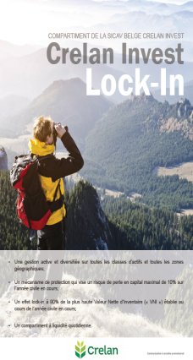
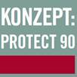
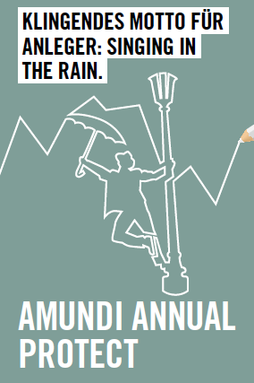
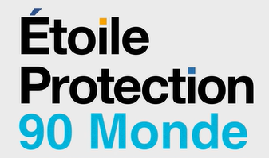
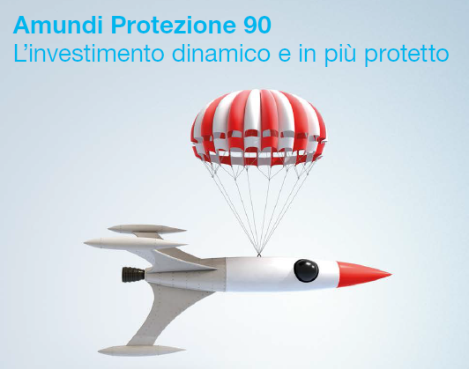
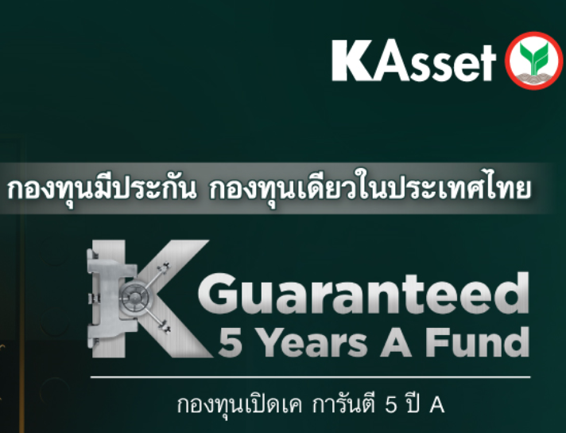
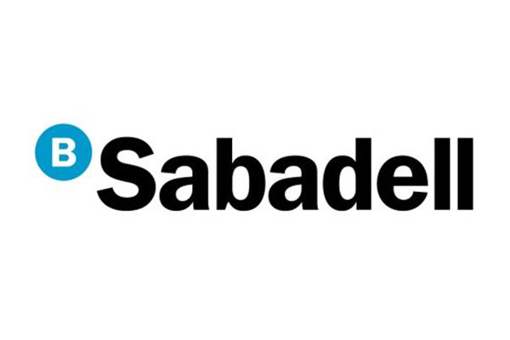
A successful worldwide distribution of the strategy
Dedicated funds
Flagship fund
Asset under management as of 28/06/2024: € 2.3 Bn
Source Amundi, data as of 28 June 2024. For illustrative purposes only.
All trademarks and logos used for illustrative purposes in this document are the property of their respective owners.

Slide 17
Key Points
1
A solution to consider for risk averse investors, in current market conditions
A flexible and active management seeking to extract value wherever it exists in a broad multi-asset investment universe
A permanent partial capital protection with an explicit guarantee of Amundi SA
An experienced team which leverages off the resources of both the structured and multi-asset investment teams
A successful distribution of the strategy in Europe and Asia
2
3
4
5
The disclosed information are as of 28 June 2024 and constitute our judgment and are subject to change without prior notice. There can be no guarantee they will be met.
For more information on the investment process and risks, please refer to the Prospectus. Given for information purposes only

Slide 18
Contents
Why now?
Why Amundi Funds Protect 90?
Why Amundi?
Performances and positioning

Slide 19
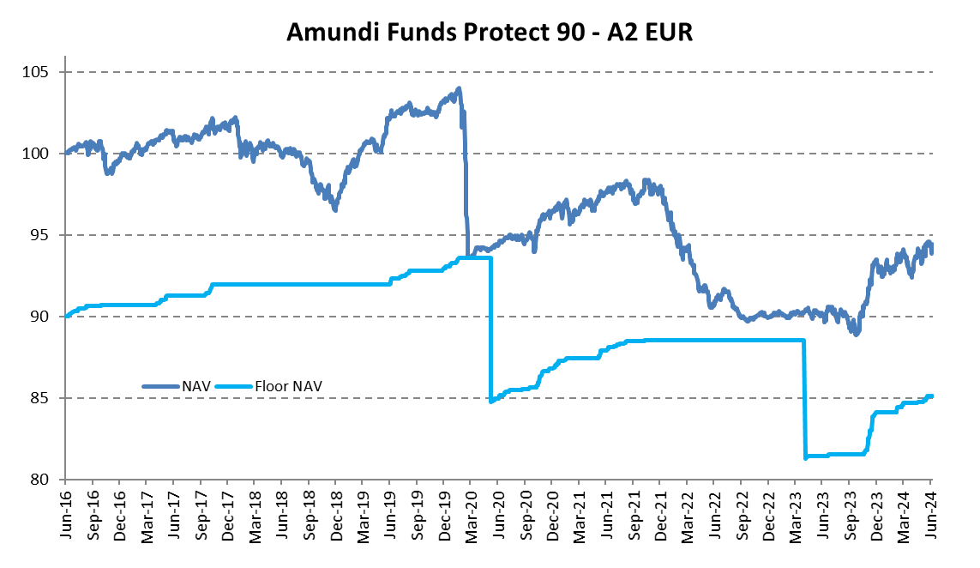
Amundi Funds Protect 90 - Share Class A2 EUR (C) - Performance
Past performance does not predict future results.
Calendar net performance | Calendar net performance
2023 | 2022 | 2021 | 2020 | 2019 | 2018 | 2017
3.75% | -8.06% | 1.34% | -6.40% | 6.35% | -4.45% | 1.79%
Net performance as of 28/06/2024 | Cumulative returns
 | Since latest reset 28/04/2024 | YTD | 1 year | 3 years | Since inception
AF Protect 90 – A2 | 1.71% | 1.13% | 4.68% | -3.36% | -5.64%
Volatility** | - | 3.34% | 3.66% | 2.82% | 3.47%
Floor NAV as of 28/06/2024
85.13 EUR
In March 2020, the protection* mechanism played its role by limiting the drawdown of the fund value linked to the market sell-offs triggered by the Covid-19 outbreak.
On June 5th, 2020, the protection* was “reset”. From that date, the protection* was equal to 90% of the NAV recorded since June 5th, 2020.
From May 2nd 2023, the protection* is equal to 90% of the highest NAV recorded since the last business day of the preceding month of April (annual reset).
Data: Amundi as of 28/06/2024. Fund launched on June 27, 2016. Performance data provided refers to Class A2 EUR (C) only, and is based upon NAV net of fees. Investment return and the principal value of an investment in the Fund or other investment product may go up or down and may result in the loss of the amount originally invested. The Sub-Fund is not managed in reference to a benchmark and has not designated a reference benchmark for the purpose of the Disclosure Regulation. * The Sub-Fund provides partial capital protection over the recommended holding period. Please see the Prospectus for complete information on the investment policy, objectives and strategy of the Fund. **Volatility is measured by Standard Deviation, a statistical measure of the historic volatility of a portfolio; a lower standard deviation indicates historically less volatility.
19

Slide 20
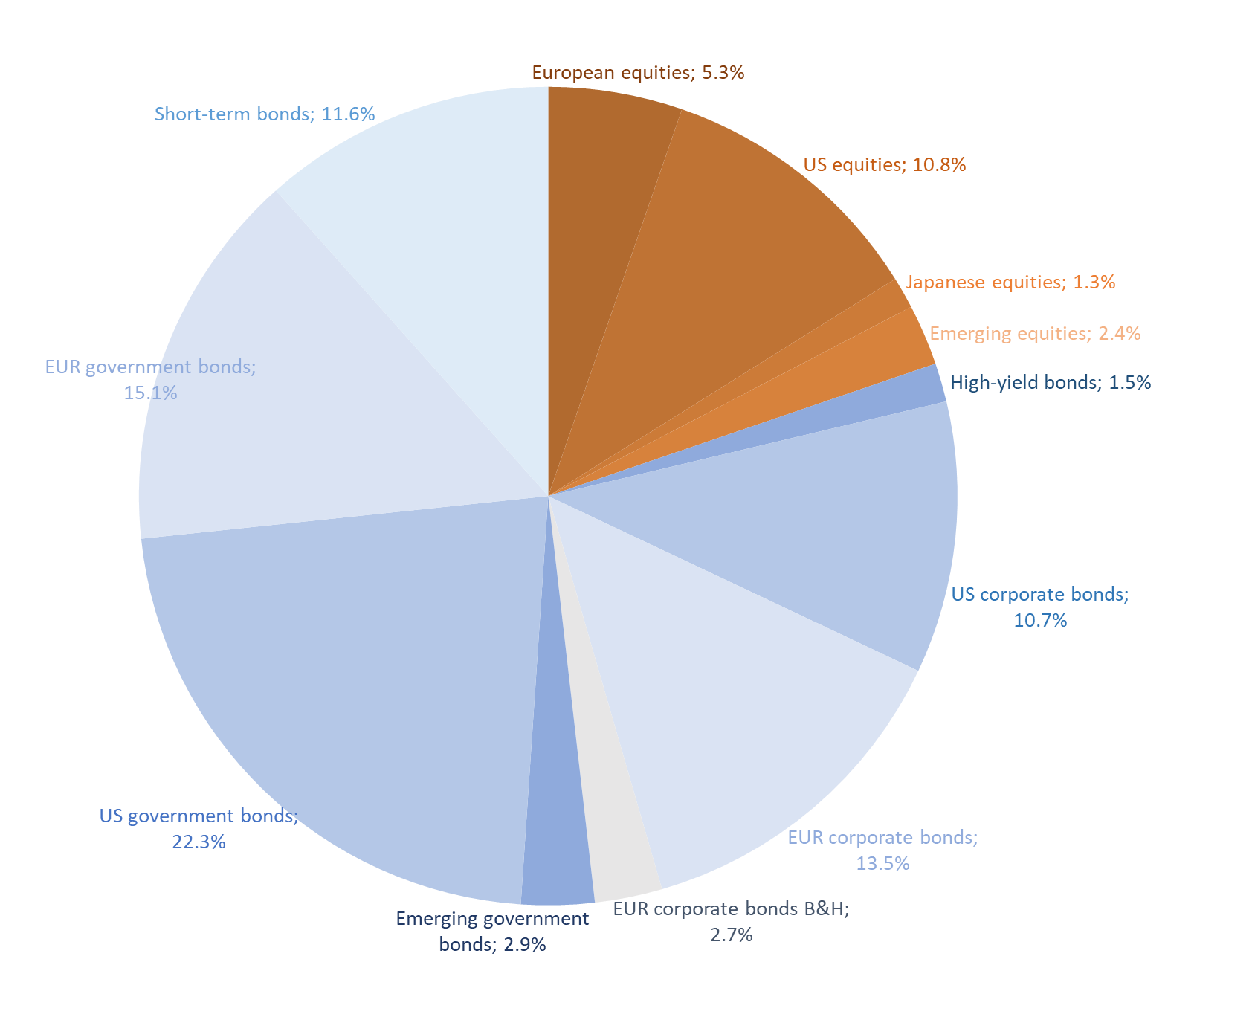
Key figures - asset allocation¹
28 June 2024
Portfolio duration 3.9
Data: Amundi. Figures as of 28/06/2024. Given for illustrative purposes only. 1. The portfolio is actively managed. Sector and asset allocations will vary over other periods and do not reflect a commitment to an investment policy or sector. Individual figures may not total due to rounding.

Slide 21
Amundi Funds Protect 90
Main Risks
Counterparty
Credit
Currency
Default
Defensive stance
Derivatives
Emerging markets
Equity
Guarantee limitations
Hedging
Interest rate
Investment fund
Leverage
Liquidity
Management
Market
Operational
Prepayment and extension
Sustainable Investment
Use of techniques and instruments
All investments involve risks and the value of investments may go down as well as up. The risk information in this slide is intended to give an idea of the main and material risks associated with this sub-fund. Any of these risks could cause the sub-fund to lose money, to perform less well than similar investments, to experience high volatility (ups and downs in NAV), or to fail to meet its objective over any period of time.
Source: Amundi Funds Protect 90 as at 28 June 2024. Descriptions of the risks associated with the Sub-Fund are provided in the Prospectus.

Slide 22
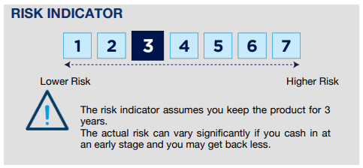
Amundi Funds Protect 90
Share Class A2 EUR (C)
What are the risks and what could I get in return?
We have classified this product as 3 out of 7, which is a medium-low risk class. This rates the potential losses from future performance at a medium-low level, and poor market conditions are unlikely to impact our capacity to pay you.
Additional risks: Market liquidity risk could amplify the variation of product performances.
The use of complex products such as derivatives can lead to an amplification of securities movements in your portfolio.
You are entitled to receive back at least 90% of your capital. Any amount over this, and any additional return, depends on future market performance and is uncertain.
Beside the risks included in the risk indicator, other risks may affect the Sub-Fund’s performance. Please refer to the Amundi Funds prospectus.
The summary risk indicator is a guide to the level of risk of this product compared to other products. It shows how likely it is that the product will lose money because of movement in the markets or because we are not able to pay you.
This slide provides you with key information about this Sub-Fund. The information is required by law to help you understand the nature and the risks of investing in this Sub-Fund. You are advised to read it so you can make an informed decision about whether to invest. As of 28 June 2024. The lowest category does not imply that there is no risk. The SRI is not guaranteed and may change over time. For more information, please refer to the Prospectus and PRIIPS KID.

Slide 23
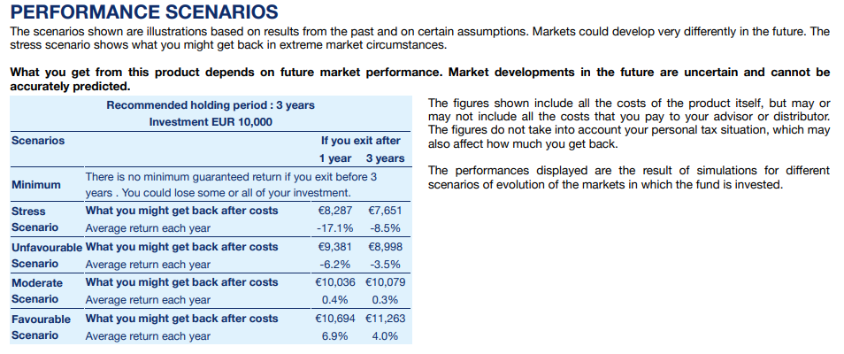
Amundi Funds Protect 90
Legal Characteristics
Past performance does not predict future results. Investment return and the principal value of an investment in the Funds or other investment product may go up or down and may result in the loss of the amount originally invested.
This slide provides you with key information about this Sub-Fund. It is not marketing material. The information is required by law to help you understand the nature and the risks of investing in this Sub-Fund. You are advised to read it so you can make an informed decision about whether to invest. As of 28 June 2024.
For more information, please refer to the Prospectus and PRIIPS KID

Slide 24
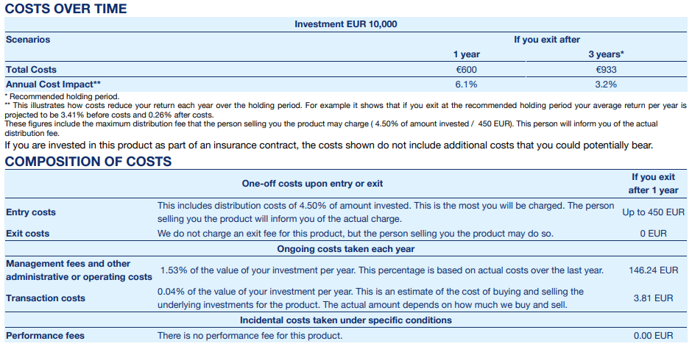
Amundi Funds Protect 90
Legal Characteristics - Continued
What are the costs ?
The person advising on or selling you this product may charge you other costs. If so, this person will provide you with information about these costs and how they affect your investment. The tables show the amounts that are taken from your investment to cover different types of costs. These amounts depend on how much you invest, and how long you hold the product. The amounts shown here are illustrations based on an example investment amount and different possible investment periods. We have assumed: - In the first year you would get back the amount that you invested (0 % annual return). For the other holding periods we have assumed the product performs as shown in the moderate scenario. - EUR 10,000 is invested.
This slide provides you with key information about this Sub-Fund. It is not marketing material. The information is required by law to help you understand the nature and the risks of investing in this Sub-Fund. You are advised to read it so you can make an informed decision about whether to invest. As of 28 June 2024.
For more information, please refer to the Prospectus and PRIIPS KID

Slide 25
Amundi Funds Protect 90
Legal characteristics
Management company | Amundi Luxemburg S.A.
Custodian | CACEIS Bank, Luxemburg branch
Guarantor | Amundi S.A.
Type of share | A2 EUR | G2 EUR
Currency of the share | EUR | EUR
ISIN Code | LU1433245245 | LU1534106825
Category of share | Accumulation
Initial minimum investment | None
Recommended minimum investment period | 3 years
Valuation frequency | Daily
Annual management fees | 1.10%
Annual administration fees (incl. guarantee) | 0.27%
Max. indirect management fees | 0.50%
Estimated ongoing charges | 1.59%
Performance fee | None
Max. conversion fee | 1.00%
Max. subscription fee | 4.5% | 3.0%
Max. redemption fee | None
Countries of registration | France, Luxembourg, Spain, Italy (G2 EUR), Austria, Germany, Finland, Greece, Bulgaria, Czech Republic, Hungary, Slovakia, UK, Singapore (Private Placement)
For more information, please refer to the Prospectus and PRIIPS KID.

Slide 26
Important Information 1/4
This material is provided to Professional Clients, including financial intermediaries, and is not intended for and should not be provided to the public.
This is a marketing communication. Please refer to the prospectus / information document and to the KID/KIID before making any final investment decisions
This document contains information about investment services provided by Amundi group companies or undertakings for collective investment in transferable securities or open-ended umbrella Irish collective asset- management vehicles (the “Funds”) established under the laws of Luxembourg and authorised for public distribution by the Commission de Surveillance du Secteur Financier or the laws of Ireland and authorized for public distribution by the Central Bank of Ireland. The management company of:
Amundi Funds, Amundi Fund Solutions, First Eagle Amundi and Amundi Index Solutions is Amundi Luxembourg S.A., 5, allée Scheffer, L-2520 Luxembourg;
CPR Invest is CPR Asset Management, 91-93 Boulevard Pasteur, 75015 Paris, France;
KBI Funds ICAV and Amundi Fund Solutions ICAV is Amundi Ireland Limited, 1 George’s Quay Plaza, George’s Quay, Dublin 2, Ireland.
This material is for information purposes only, is not a recommendation, financial analysis or advice, and does not constitute a solicitation, invitation or offer to purchase or sell any the Funds or services described herein in any jurisdiction where such offer, solicitation or invitation would be unlawful.
This material has not been submitted for regulatory approval and is solely for issue in permitted jurisdictions and to persons who may receive it without breaching applicable legal or regulatory requirements. The information contained in this document is confidential and shall not, without prior written approval of Amundi Ireland Limited (“Amundi”), be copied, reproduced, modified, or distributed, to any third person or entity in any country.
The Funds described in this document may not be available to all investors and may not be registered for public distribution with the relevant authorities in all countries.
Please note that the management company may decide to terminate the arrangements made for the marketing of its collective investment undertakings in a Member State of the EU in respect of which it has made a notification.
A summary of information about investors’ rights and collective redress mechanisms can be found in English on the regulatory page at https://about.amundi.com/Metanav-Footer/Footer/Quick-Links/Legal-documentationthat the management company may de-notify arrangements made for marketing as regards units/shares of the Fund in a Member State of the EU in respect of which it has made a notification.
Investment involves risk. The decision of an investor to invest in the Funds should take into account all the characteristics or objectives of the Funds. Past performance does not predict future results. Investment return and the principal value of an investment in the Funds or other investment product may go up or down and may result in the loss of the amount originally invested. All investors should seek professional advice prior to any investment decision, in order to determine the risks associated with the investment and its suitability. It is the responsibility of investors to read the legal documents in force in particular the current prospectus for each Fund. Subscriptions in the Funds will only be accepted on the basis of their latest prospectus in English or in local language in EU countries of registration, and/or the Key Investor Information Document / Key Information Document (“KIID”/ “KID” available in local language in EU countries of registration) which, together with the latest annual and semi-annual reports may be obtained, free of charge, at the registered office of Amundi Luxembourg S.A. or at www.amundi.lu. In Italy, this documentation is available at www.amundi.it. In Ireland, this documentation is available at www.amundi.ie or, for KBI Funds ICAV, at www.kbiglobalinvestors.com. Information relating to costs and charges of the Funds may be obtained from the KIID/KID.
The performance data do not take account of the commissions and costs incurred on the issue and redemption of units/shares of the Funds.

Slide 27
Important Information 2/4
Information on sustainability-related aspects can be found at https://about.amundi.com/Metanav-Footer/Footer/Quick-Links/Legal-documentation.
In EEA Member States, the content of this document is approved by Amundi for use with Professional Clients (as defined in EU Directive 2004/39/EC) only and shall not be distributed to the public. Amundi Ireland Limited is authorised and regulated by the Central Bank of Ireland. KBI Global Investors Ltd is regulated by the Central Bank of Ireland and deemed authorised and regulated by the Financial Conduct Authority. The nature and extent of consumer protections may differ from those for firms based in the UK. Details of the Temporary Permissions Regime, which allows EEA-based firms to operate in the UK for a limited period while seeking full authorisation, are available on the Financial Conduct Authority’s website. Société Générale, Dublin Branch 3rd Floor, IFSC House, IFS, Dublin 1 is the facilities agent for those sub-funds of Amundi Funds, First Eagle Amundi registered in Ireland.
In the UK, this document is issued by Amundi (UK) Limited, 77 Coleman Street, London, EC2R 5BJ, United Kingdom. Amundi (UK) Limited is authorised and regulated by the Financial Conduct Authority (“FCA”) and entered on the FCA’s Financial Services Register under number 114503. This may be checked at https://register.fca.org.uk/ and further information of its authorisation is available on request. Amundi Funds SICAV, First Eagle Amundi SICAV, Amundi Index Solutions, CPR Invest SICAV, KBI Funds ICAV and Amundi Fund Solutions ICAV are recognised schemes for the purposes of Section 264 of the Financial Services and Markets Act 2000 (the “FSMA”) of the UK and can be promoted and sold direct to the public in the United Kingdom subject to compliance with the FSMA and applicable regulations made thereunder. Where a fund is an unregulated collective investment scheme under the FSMA it will not carry the protection provided by the UK regulatory system. This document is addressed only to those persons in the UK falling within one or more of the following exemptions from the restrictions in s 238 FSMA:
• authorised firms under FSMA and certain other investment professionals falling within article 14 of the FSMA (Promotion of Collective Investment Schemes) (Exemptions) Order 2001, as amended (the “CIS Order”) and their directors, officers and employees acting for such entities in relation to investment;
• high value entities falling within article 22 CIS Order and their directors, officers and employees acting for such entities in relation to investment;
• other persons who are in accordance with the Rules of the FCA prior to 1 November 2007 classified as Intermediate Customers or Market Counterparties or on or thereafter classified as Professional Clients or Eligible Counterparties.
The distribution of this document to any person in the UK not falling within one of the above categories is not permitted by Amundi (UK) Limited and may contravene FSMA. No person in the UK falling outside those categories should rely or act on it for any purposes whatsoever. Where a fund is an unregulated collective investment scheme under the UK Financial Services and Markets Act 2000 (“FSMA”) it will not carry the protection provided by the UK regulatory system.
In Switzerland, this document is for Qualified Investors (as defined in Swiss Collective Investment Schemes Act of 23 June 2006 as amended or supplemented) use only and shall not be offered to the public. The Representative and Paying Agent for Funds registered for public offering in Switzerland are, in respect of Amundi Funds, First Eagle Amundi and Amundi Index Solutions: Representative - CACEIS (Switzerland) SA and Paying Agent - CACEIS Bank, Nyon Branch both at 35 Route de Signy, Case postale 2259, CH-1260 Nyon; KBI Funds ICAV: Representative – ACOLIN Fund Services AG, Affolternstrasse 56, CH-8050 Zurich and Paying Agent – NPB Neue Privat Bank AG, Limmatquai 1, CH-8001 Zurich. Free copies of the prospectus, key investor information documents, annual and semi-annual reports, management regulations and other information are available at the representative’s address shown above.
In France, a free prospectus is available from Amundi Asset Management, 91-93 boulevard Pasteur -75015 Paris - France - 437 574 452 RCS Paris France or from the centralisateur of the Funds which in the case of Amundi Funds, Amundi Index Solutions and CPR Invest SICAV is CACEIS Bank SA, 1-3 place Valhubert, 75013 Paris and in the case of First Eagle Amundi SICAV is Société Générale, 29 Boulevard Haussmann, 75008 Paris.

Slide 28
Important Information 3/4
In Germany, for additional information on the Fund, a free prospectus may be requested from Amundi Deutschland GmbH, Arnulfstr. 124-126 80636 Munich, Germany (Tel. +49.89.99.226.0). The information and paying agent for Amundi Fund Solutions ICAV is Marcard Stein & CO AG, Ballindamm 36, 20095 Hambourg, Germany.
In Austria the paying agents for Funds registered for public distribution are, in respect of Amundi Fund Solutions: UniCredit Bank Austria AG, Rothschildplatz 1, A-1020 Vienna; Amundi Funds, Amundi Index Solutions and First Eagle Amundi: Société Générale, Vienna Branch, Prinz Eugen Strasse 8 - 10/5/Top 11, A-1040 Vienna; CPR Invest: Raiffeisen Bank International AG, Am Stadtpark 9, A-1030 Wien; and KBI Funds ICAV: Erste Bank der oesterreichischen Sparkassen AG, Am Belvedere 1, A-1100 Vienna.
In Spain, the Funds are foreign undertakings for collective investment registered with the CNMV and numbered Amundi S.F. (493); Amundi Fund Solutions (1333); Amundi Fund Solutions ICAV (1969); Amundi Funds (61) First Eagle Amundi (111); Amundi Index Solutions (1495); CPR Invest (1564) and KBI Funds ICAV (1248). Any investment in the Funds or their respective sub-funds must be made through a registered Spanish distributor. Amundi Iberia SGIIC, SAU, is the main distributor of the Funds in Spain, registered with number 31 in the CNMV's SGIIC registry, with address at Pº de la Castellana 1, Madrid 28046. A list of all Spanish distributors may be obtained from the CNMV at www.cnmv.es. Units/shares may only be acquired on the basis of the most recent prospectus, key investor information document and further current documentation, which may be obtained from the CNMV.
In Chile and Peru, this document is approved for use by Administradora de Fondos de Pensiones/Pension Fund Administrators and other institutional investors.
In Mexico, this document is approved for use with institutional investors. It may not be distributed to third parties or to the public.
In Singapore, this document is provided solely for the use of distributors and financial advisors only and is not to be distributed to the retail public. Distribution occurs through Amundi Singapore Ltd, 80 Raffles Place, UOB Plaza 1, #23-01, Singapore 048624. This document contains information about certain sub-funds of Amundi Funds, First Eagle Amundi SICAV and Amundi Index Solutions which may be registered as recognised schemes in Singapore under the Securities and Futures Act (Cap. 289) of Singapore (“SFA”), or notified as restricted schemes under the Sixth Schedule to the Securities and Futures (Offers of Investments) (Collective Investment Schemes) Regulations 2005. For the sub-funds or relevant unit/share classes notified as restricted schemes in Singapore, such sub-funds or relevant unit/share classes are not authorised or recognised by the Monetary Authority of Singapore ("MAS") and are not allowed to be offered to the Singapore retail public. Accordingly, this document and the material contained within, may not be circulated or distributed, nor may the relevant units/shares be offered or sold, or be made the subject of an invitation for subscription or purchase, whether directly or indirectly, to persons in Singapore other than (i) to an institutional investor under Section 304 of the SFA, (ii) to a relevant person pursuant to Section 305(1), or any person pursuant to Section 305(2), and in accordance with the conditions specified in Section 305 of the SFA, or (iii) otherwise pursuant to, and in accordance with the conditions of, any other applicable provision of the SFA. In other Asian jurisdictions, for use by licensed intermediaries only and not to be distributed to the public.
This information is not for distribution and does not constitute an offer to sell or the solicitation of any offer to buy any securities or services in the United States or in any of its territories or possessions subject to its jurisdiction to or for the benefit of any U.S. Person (as defined in the prospectus of the Funds). The Funds have not been registered in the United States under the Investment Company Act of 1940 and units/shares of the Funds are not registered in the United States under the Securities Act of 1933.
This document is not intended for and no reliance can be placed on this document by persons falling outside of these categories in the above mentioned jurisdictions. In jurisdictions other than those specified above, this document is for the sole use of the professional clients and intermediaries to whom it is addressed. It is not to be distributed to the public or to other third parties and the use of the information provided by anyone other than the addressee is not authorised.

Slide 29
Important Information 4/4
This material is based on sources that Amundi considers to be reliable at the time of publication. Data, opinions and analysis may be changed without notice. Amundi accepts no liability whatsoever, whether direct or indirect, that may arise from the use of information contained in this material. Amundi can in no way be held responsible for any decision or investment made on the basis of information contained in this material.
Date of publication: 12 July 2024
Doc ID# 2854943
© 2024 Morningstar. All Rights Reserved. The information, data, analyses and opinions (“Information”) contained herein: (1) include the proprietary information of Morningstar; (2) may not be copied or redistributed; (3) do not constitute investment advice; (4) are provided solely for informational purposes; (5) are not warranted to be complete, accurate or timely; and (6) may be drawn from fund data published on various dates. Morningstar is not responsible for any trading decisions, damages or other losses related to the Information or its use. Please verify all of the Information before using it and don’t make any investment decision except upon the advice of a professional financial adviser. Past performance is no guarantee of future results. The value and income derived from investments may go down as well as up.
Lipper is not responsible for the accuracy, reliability or completeness of the information that you obtain. In addition, Lipper will not be liable for any loss or damage resulting from information obtained from Lipper or any of its affiliates. © Thomson Reuters 2024. All rights reserved.
The Funds or securities referred to herein are not sponsored, endorsed, or promoted by MSCI, and MSCI bears no liability with respect to any such Funds or securities or any index on which such Funds or securities are based. The offering documents of the Funds contain a more detailed description of the limited relationship MSCI has with Amundi and any relevant Funds.

