Slide 1
Amundi Funds
Protect 90
November 2025
Marketing Communication - For Professional Clients only.

Slide 2
Why Amundi?
1

Slide 3
A diversified protected investment, bringing together the expertise of two well-established and experienced teams
Multi-asset
Structured solutions
Flexible protected asset management
Multi-asset expertise
€270bn in assets under management
200+ experts leveraging Amundi’s full breadth of expertise
13 countries - Global investor with local presence in Europe, Asia & North America
+35-year experience in multi-asset solutions
Global leading platform
Structured Solutions expertise
€94bn in assets under management
50+ investment professionals
More than 35 years of global expertise
#2 in Europe in guaranteed products*
Clients
Retail networks, third party distribution, institutions
Source: Amundi & Broadridge as of 30/06/2025 - * Source: Broadridge Combined Saleswatch Consortium (open-ended funds marketed in Europe, excl. mandates, dedicated funds and EMTNs), Dec. 2024

Slide 4














The investment teams
FIXED
INCOME
EQUITY
MULTI-ASSET
EMERGING
US
EXPERTISE
LIQUIDITY
SOLUTIONS
ALTERNATIVE
& REAL ASSETS
ETF
& INDEXING
STRUCTURED
SOLUTIONS
Raphael Sobotka Head of Multi-Asset flexible Retirement & Risk Premia
Abdelaziz Lamaaizi CIO Structured Solutions
Bruno Saugnac
Head of Flexible & Target Risk Strategies
Flexible & Target
Cross Assets, Rates, Currencies
37 years experience
Éric Voelckel PM, Flexible Desk Equities 37 years experience
Nicolas Moutalib 11 years experience
Mickaël Levier
Head of Hybrid Fund Investment team
18 years experience
Bertrand de Dinechin PM, Flexible Desk Rates, Credit 26 years experience
Alain Baron PM, Target Risk Desk Rates, FX 27 years experience
Laurent Gouzilh 14 years experience
Laurence Ribeyron 28 years experience
Florence Duperrier PM, Flexible Desk Equities 24 years experience
Thierry Morel PM, Target Risk Desk Equities, Modelling 18 years experience
Aurélien Léon 18 years experience
The dynamic and risk protected strategies investment team is dedicated to flexible funds and multi-asset solutions for retail networks. Headed by Bruno Saugnac, the team is covering complementary expertise such as equity, fixed-income, quantitative research and fund selection. Within this team, two portfolio managers are dedicated to risk-protected strategies, Alain Baron and Thierry Morel.
The structured solutions investment teams are dedicated to the asset management of portfolios with a guarantee or a protection of the capital. A specific team, the Hybrid Structured Fund Management team, is in charge of the management of multi-asset protected funds, in particular funds managed with portfolio insurance technique. The team, headed by Mickaël Levier, consists of five professionals with an average of 20 years of experience in the industry.
Source: Amundi as of November 2025. There can be no assurance that the professionals currently employed by AMUND will continue to be employed by AMUNDI or that the past performance or success of any such professional serves as an indicator of such professional's future performance or success. For illustrative purposes only.

Slide 5



























A successful worldwide distribution of the strategy
Best Structured Investment Product Award - Multi-asset (Hong- Kong & Japan) at The Asset’s Triple A Asian Awards 2018
Total assets under management
€1.9bn
Source Amundi, data as of 30/11/2025 - For illustrative purposes only.
All trademarks and logos used for illustrative purposes in this document are the property of their respective owners.
Excellence in innovation 2025
by Fund Selector Asia

Slide 6
Market opportunities
2

Slide 7


In a complex and uncertain environment, investors look for protection
Low real interest rates
Political, economic and financial uncertainty
Low inflation-adjusted remuneration
on lowest-risk assets
An environment that may pose a challenge
to all risk-taking decisions
Amundi offers a new generation of partially protected investments:
Amundi Funds Protect 90
A protected investment means adapting to market conditions with the double objective of seeking performance¹ and partially protecting savings².
Source Amundi as at November 2025. For illustrative purposes only, may be subject to change without prior notice. 1. The Fund does not offer a performance guarantee. 2. The Fund aims to provide a permanent partial protection of capital invested over the recommended holding period. Please see the Prospectus for complete information on the investment policy, objectives and strategy of the fund.

Slide 8
Why this fund?
3

Slide 9


A new generation of protected investment
Seeking to reconcile what we consider to be two of the main expectations of investors
Search for performance¹
Permanent partial capital protection²
Amundi Funds Protect 90
seeks a moderate capital growth through an actively managed portfolio based on fundamental market analysis and investment with convictions, with an explicit permanent partial capital protection over the recommended holding period.
Our goal is to maximize the performance of the portfolio within a risk limit².
Source Amundi as at November 2025. 1. The Fund does not offer a performance guarantee. 2. Please see the Prospectus for complete information on the investment policy, objectives and strategy of the Fund. The Fund benefits from a daily protection representing 90% of the highest NAV (Net Asset Value) recorded from the last business day of the preceding month of April regardless of the subscription date.

Slide 10


The key points of Amundi Funds Protect 90
The objective of Amundi Funds Protect 90 is to participate in the evolution of the financial markets
with a permanent partial capital protection¹
Search for performance²
Multi-asset: a broad and diversified investment universe
An active and flexible management based on fundamental market analysis and investment convictions
SFDR Article 8
Permanent partial capital protection¹
A protection equal to 90% of the highest net asset value recorded since the last business day of the preceding month of April (annual reset)
A formal guarantee granted by the Guarantor (A+ Fitch Ratings)
Risk Profile: SRI 3
Availability
Savings available at all times
Simplicity
We seek to provide investors with an understandable message
Source: Amundi Asset Management as of November 2025. 1. For more product-specific information and information on the investment policy, strategy and objectives of the Fund, please refer to the Prospectus. 2. The Fund does not offer a performance guarantee. The SRI corresponds to the risk/reward profile shown in the PRIPS KID. The lowest category does not imply that there is no risk. The SRI is not guaranteed and may vary over time.

Slide 11
Our investment process & philosophy
4

Slide 12



Search for performance
A broad and diversified investment universe¹
Try to take advantage of all opportunities for performance on the markets
All asset classes
All geographic regions
and sectors
All types of instruments
An active and flexible investment strategy
To constantly adapt to different market situations
In case of favourable market conditions, the sub-fund seeks to prioritise risky assets¹ to capture their performance potential²
Preferred asset classes
Equities, bonds
Risky assets
Equities
Bonds
Money market
In case of bear or uncertain markets, the portfolio’s level of risk is reduced and the sub-fund shifts towards less risky assets¹
Preferred asset classes
Bonds, money market
Risky assets
Source: Amundi Asset Management as of November 2025. 1. The Fund invests in all types of asset classes, allocating between a growth component (diversified higher risk investments) and a conservative component (lower risk investments). For more product-specific information, please refer to the Prospectus 2. The Fund does not offer a performance guarantee.

Slide 13
Partial and permanent capital protection¹
90% of the highest NAV recorded since the last business day of the preceding month of April
Cumulative performance
At the start of every annual period Y (1 May – 30 April), the Floor NAV is recalculated as 90% of the NAV of the last business day of the previous annual period (Y-1).
The Floor NAV increases each time the sub-fund’s NAV reaches a new high point during the annual period
If the NAV decreases during the period, the Floor NAV remains equal to 90% of the highest NAV since the last day of the preceding annual period
Entry point
NAV = EUR 100 Floor NAV = EUR 90
Exit point
NAV = EUR 111.8 Floor NAV = EUR 105.50
Source: Amundi Asset Management as of November 2025. Graph provided for illustrative purposes only. It serves in no way as an indication of the future performance of Amundi Funds Protect 90 or a guarantee of future returns. 1. The Fund aims to provide a permanent partial protection of capital invested over the recommended holding period. Please see the Prospectus for complete information on the investment policy, objectives and strategy of the Fund.

Slide 14
The sub-fund’s behavior depending on the markets
In the event of a favourable market trend
The trend of the net asset value is linked to the markets.
Investors can benefit from the increased level of protection of the sub-fund’s net asset value and of the partial and progressive lock-in of sub-fund performances.
However, should risky assets¹ rise, the mechanism for ensuring such protection may limit the sub-fund’s ability to gain from this rise².
In the event of an unfavourable market trend
If the net asset value experiences a decline, which may lead in case of significant and/or persistent bear markets to full money market investment, the sub-fund may no longer take advantage of the performance potential of the dynamic assets² until the next reset date (next 1st business day of May).
Source: Amundi Asset Management as of November 2025. Graphs provided for illustrative purposes only, may be subject to change without prior notice. They do not serve to act as an indicator of future performance of the Fund. 1. The Sub-Fund invests in all types of asset classes, allocating between a growth component (diversified higher risk investments) and a conservative component (lower risk investments). For more product-specific information on the investment policy, strategy and objectives of the Fund, please refer to the Prospectus. 2. The Sub-Fund does not offer a performance guarantee.

Slide 15
Positioning and performance
5

Slide 16
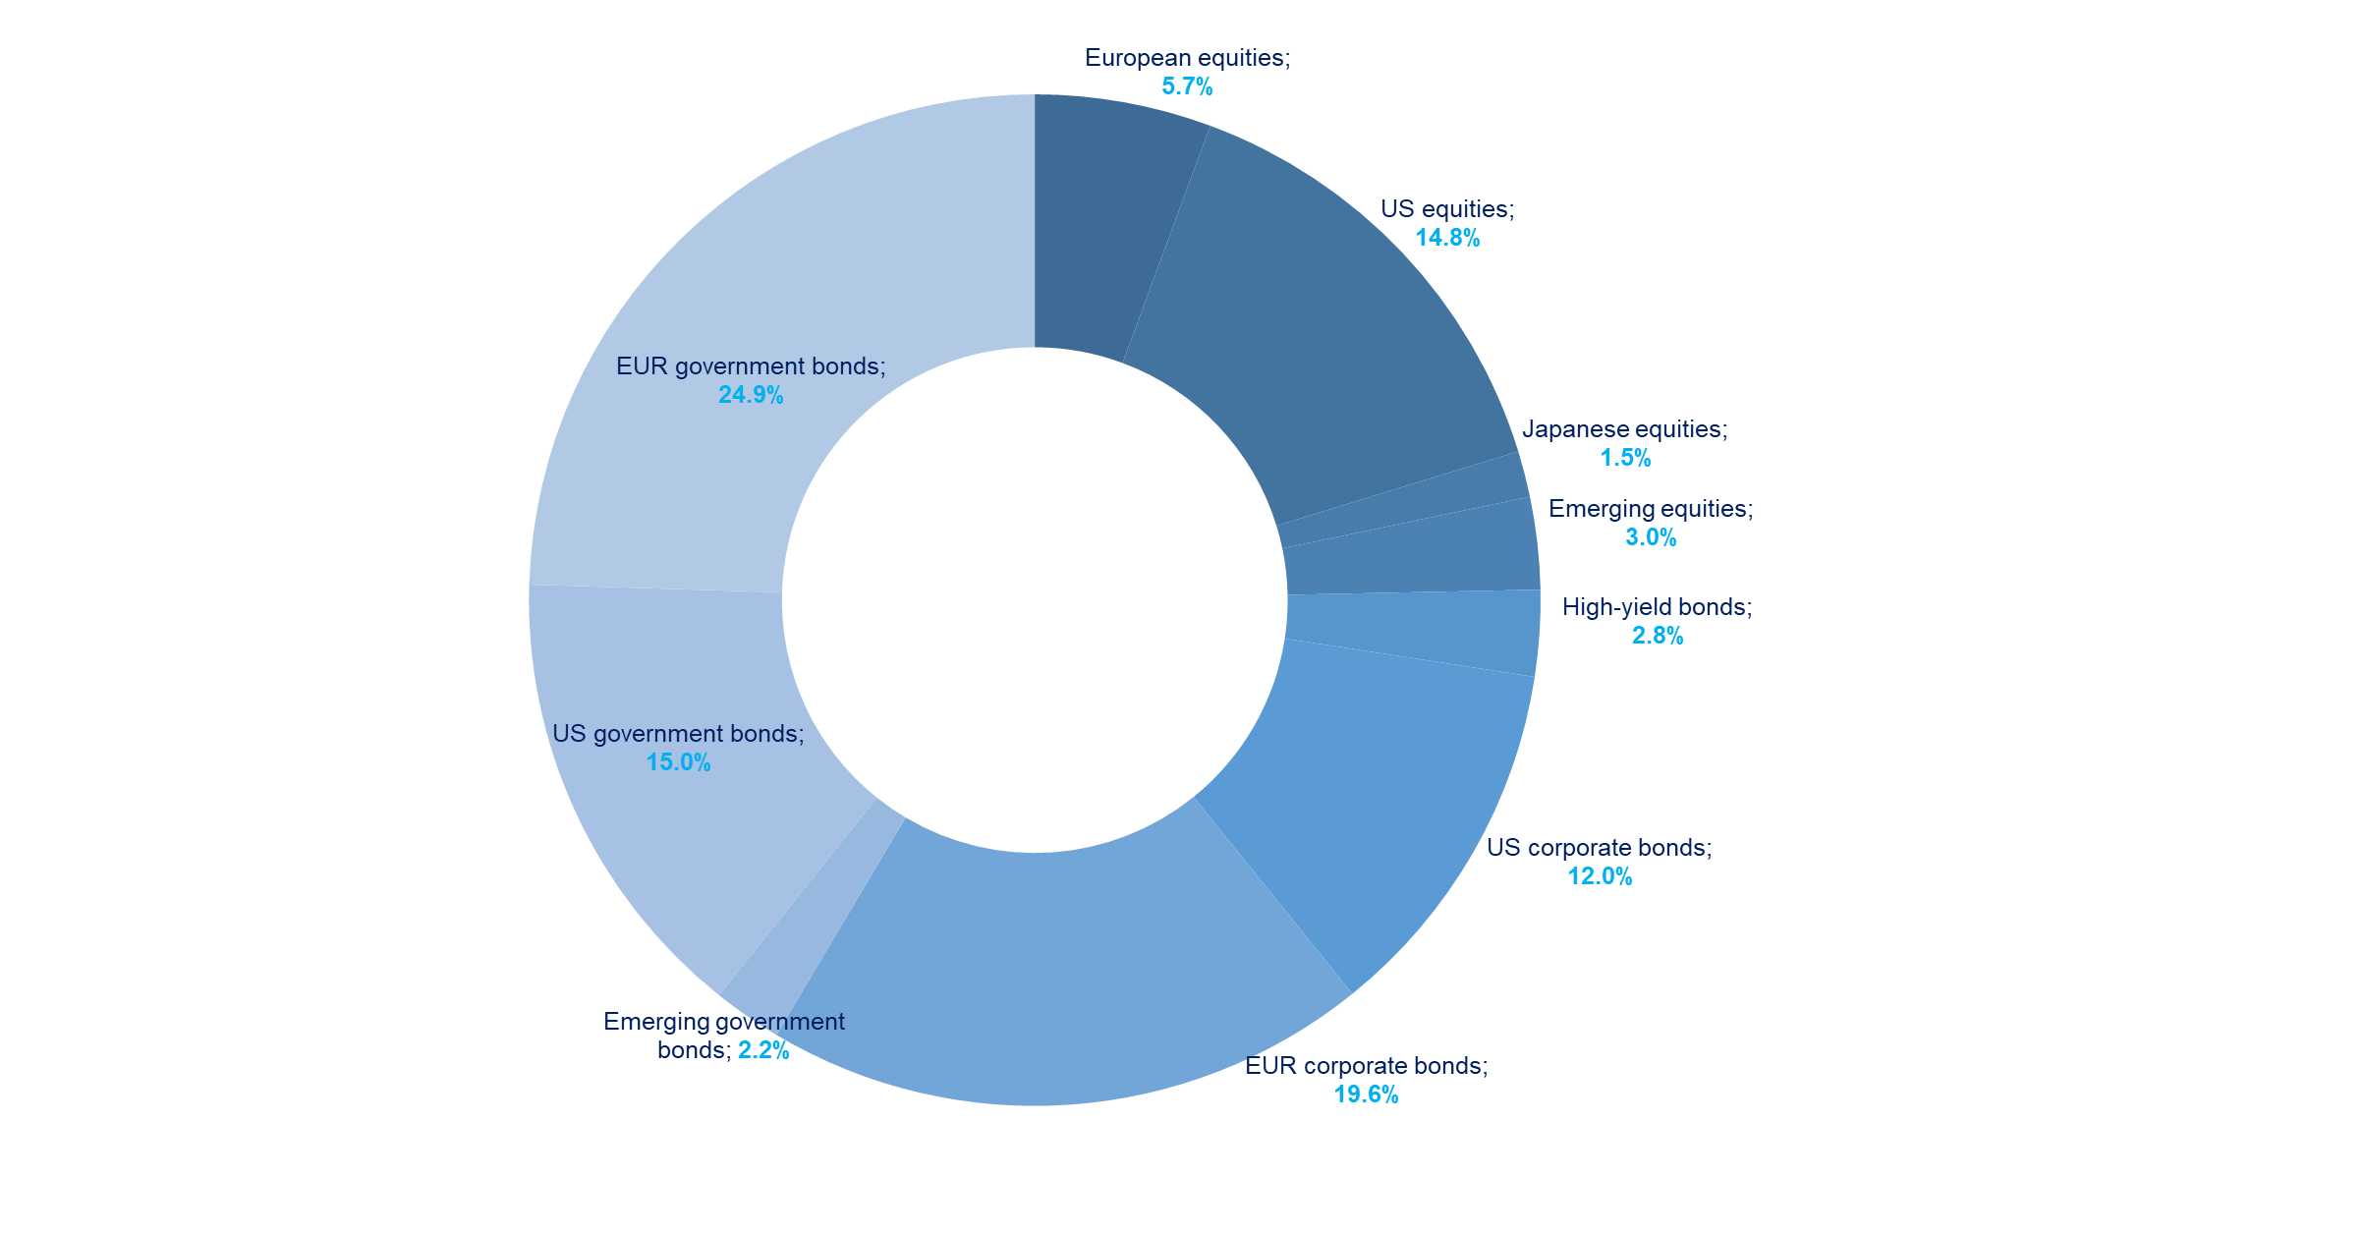
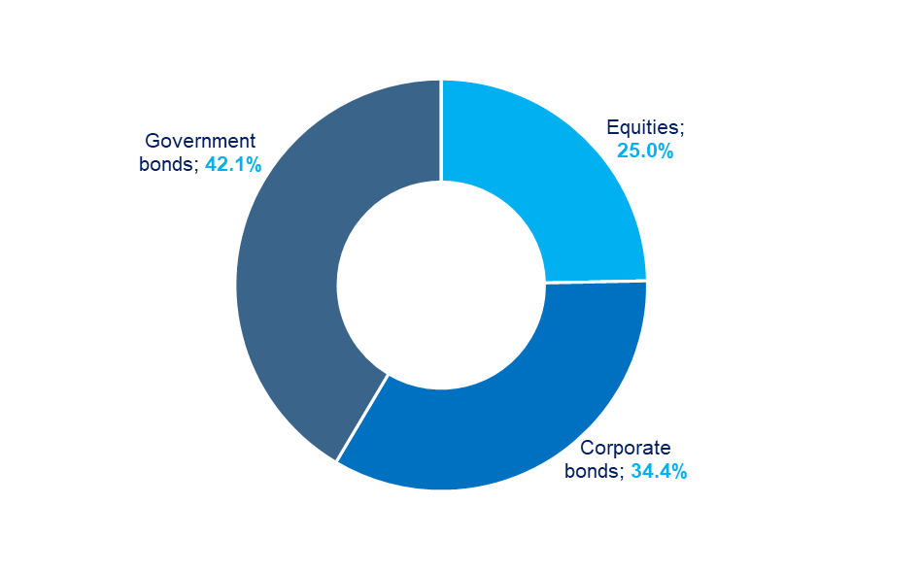
Key figures - asset allocation¹
30 November 2025
Portfolio duration 3.9
Data: Amundi. Figures as of 30/11/2025. Given for illustrative purposes only. 1. The portfolio is actively managed. Sector and asset allocations will vary over other periods and do not reflect a commitment to an investment policy or sector. Individual figures may not total due to rounding.

Slide 17
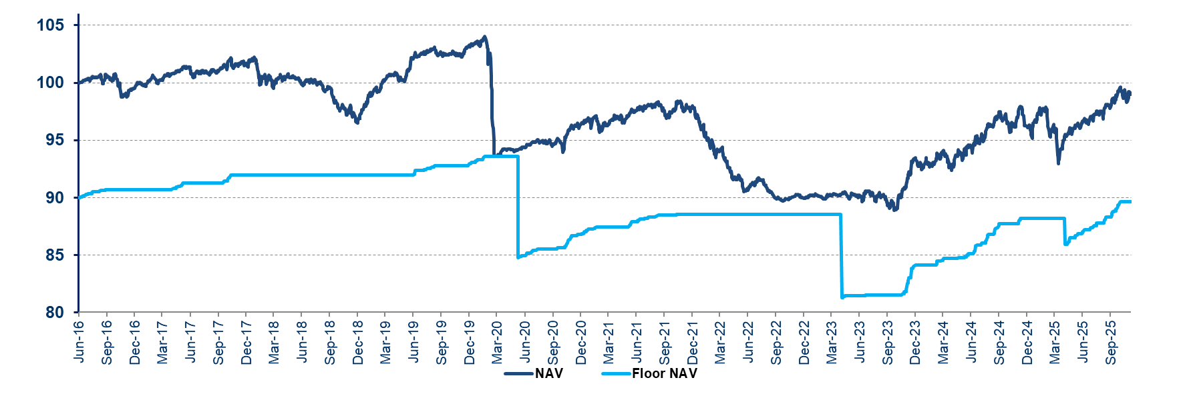
Amundi Funds Protect 90 - Share Class A2 EUR (C) - Performance
Past performance does not predict future results
Calendar net performance |  | Calendar net performance
2024 | 2023 | 2022 | 2021 | 2020 | 2019 | 2018 | 2017
2.98% | 3.75% | -8.06% | 1.34% | -6.40% | 6.35% | -4.45% | 1.79%
Net performance as of 30/11/2025 | Cumulative returns
 | Since latest reset 30/04/2025 | YTD | 1 year | 3 years | Since inception
AF Protect 90 - A2 | 4.13% | 3.28% | 1.75% | 10.06% | -0.76%
Volatility** | 2.95% | 4.28% | 4.28% | 3.64% | 3.60%
Floor NAV as of 30/11/2025
89.65 EUR
Amundi Funds Protect 90 - A2 EUR
In March 2020, the protection* mechanism played its role by limiting the drawdown of the fund value linked to the market sell-offs triggered by the Covid-19 outbreak.
On June 5th, 2020, the protection* was “reset”. From that date, the protection* was equal to 90% of the NAV recorded since June 5th, 2020.
From May 2nd 2023, the protection* is equal to 90% of the highest NAV recorded since the last business day of the preceding month of April (annual reset).
Data: Amundi as of 30/11/2025. Fund launched on June 27, 2016. Performance data provided refers to Class A2 EUR (C) only, and is based upon NAV net of fees. Investment return and the principal value of an investment in the Fund or other investment product may go up or down and may result in the loss of the amount originally invested. The Sub-Fund is not managed in reference to a benchmark and has not designated a reference benchmark for the purpose of the Disclosure Regulation. * The Sub-Fund provides partial capital protection over the recommended holding period. Please see the Prospectus for complete information on the investment policy, objectives and strategy of the Fund. **Volatility is measured by Standard Deviation, a statistical measure of the historic volatility of a portfolio; a lower standard deviation indicates historically less volatility.

Slide 18
Amundi Funds Protect 90
Legal Characteristics
Management company | Amundi Luxemburg S.A.
Custodian | CACEIS Bank, Luxemburg branch
Guarantor | Amundi S.A.
Type of share | A2 EUR | G2 EUR
Currency of the share | EUR | EUR
ISIN Code | LU1433245245 | LU1534106825
Category of share | Accumulation
Initial minimum investment | None
Recommended minimum investment period | 3 years
Valuation frequency | Daily
Annual management fees | 1.10%
Annual administration fees (incl. guarantee) | 0.27%
Max. indirect management fees | 0.50%
Estimated ongoing charges | 1.67%
Performance fee | None
Max. conversion fee | 1.00%
Max. subscription fee | 4.5% | 3.0%
Max. redemption fee | None
Countries of registration | France, Luxembourg, Spain, Italy (G2 EUR), Austria, Germany, Finland, Greece, Bulgaria, Czech Republic, Hungary, Slovakia, UK, Singapore (Private Placement)
Source: Amundi As of 30 November 2025. For more information, please refer to the Prospectus and PRIIPS KID.

Slide 19

Amundi Funds Protect 90
Share Class A2 EUR (C)
Main risks
Equity | Guarantee limitations
Counterparty | Hedging
Defensive stance | High Yield
Credit | Interest rate
Currency | Investment fund
Default | Leverage
Derivatives | Liquidity
Management | Market
MBS/ABS | Operational
Prepayment and extension | Sustainable Investment
Emerging markets | Use of techniques and instruments
Risk indicator*
1
2
3
3
4
5
6
7
Higher risk
Lowest risk
The risk indicator assumes you keep the product for 3 years.
The summary risk indicator is a guide to the level of risk of this product compared to other products. It shows how likely it is that the product will lose money because of movement in the markets or because we are not able to pay you. We have classified this product as 3 out of 7, which is a medium-low risk class. This rates the potential losses from future performance at a medium-low level, and poor market conditions are unlikely to impact our capacity to pay you.
Additional risks: Market liquidity risk could amplify the variation of product performances. The use of complex products such as derivatives can lead to an amplification of securities movements in your portfolio. You are entitled to receive back at least 90% of your capital. Any amount over this, and any additional return, depends on future market performance and is uncertain. Beside the risks included in the risk indicator, other risks may affect the Sub-Fund’s performance. Please refer to the Amundi Funds prospectus.
All investments involve risks. The risk information in this slide is intended to give an idea of the main risks associated with this Sub-Fund. Any of these risks could negatively impact the value of the Sub-Fund. Please refer to the Prospectus and the KID for class A2 EUR .
Source: Amundi as of 30 November 2025. *The Summary Risk Indicator(SRI) represents the risk and return profile as presented in the Key Information Document (KID). The lowest category does not imply that there is no risk. The SRI is not guaranteed and may change over time. For further information, please see the Prospectus and the PRIIPs KID available at the website.

Slide 20
What are the costs?
Amundi Funds Protect 90 - A2 EUR (C)
The person advising on or selling you this product may charge you other costs. If so, this person will provide you with information about these costs and how they affect your investment. The tables show the amounts that are taken from your investment to cover different types of costs. These amounts depend on how much you invest, and how long you hold the product. The amounts shown here are illustrations based on an example investment amount and different possible investment periods.
  We have assumed:
  In the first year you would get back the amount that you invested (0% annual return). For the other holding periods we have assumed the product performs as shown in the moderate scenario.
  EUR 10,000 is invested.
Costs over time
Investment EUR 10,000
Scenarios | If you exit after
 | 1 year | 3 years*
Total Costs | $612 | $989
Annual Cost Impact** | 6.2% | 3.3%
* Recommended holding period.
** This illustrates how costs reduce your return each year over the holding period. For example it shows that if you exit at the recommended holding period your average return per year is projected to be 4.69% before costs and 1.37% after costs.
Source: Amundi As of 30 November 2025. This document provides you with key investor information about this Sub-Fund. The information is required by law to help you understand the nature and the risks of investing in this Sub-Fund. You are advised to read it so you can make an informed decision about whether to invest. The costs information in this slide may not be exhaustive and the Fund may incur other expenses. For further information on costs, charges and other expenses, please see the Prospectus and PRIIPS KID.

Slide 21
What are the costs?
Amundi Funds Protect 90 - A2 EUR (C)
Composition of costs
One-off costs upon entry or exit |  | If you exit after 1 year
Entry costs | This includes distribution costs of 4.50% of amount invested. This is the most you will be charged. The person selling you the product will inform you of the actual charge. | Up to 450 EUR
Exit costs | We do not charge an exit fee for this product, but the person selling you the product may do so. | 0.00 EUR
One-off costs taken each year
Management fees and other administrative or operating costs | 1.67% of the value of your investment per year. This percentage is based on actual costs over the last year. | 159.49 EUR
Transaction costs | 0.03% of the value of your investment per year. This is an estimate of the costs incurred when we buy and sell the underlying investments for the product. The actual amount will vary depending on how much we buy and sell. | 2.52 EUR
Incidental costs taken under specific conditions
Performance fees | There is no performance fee for this product. | 0 EUR
Source: Amundi As of 30 November 2025. This document provides you with key investor information about this Sub-Fund. The information is required by law to help you understand the nature and the risks of investing in this Sub-Fund. You are advised to read it so you can make an informed decision about whether to invest. The costs information in this slide may not be exhaustive and the Fund may incur other expenses. For further information on costs, charges and other expenses, please see the Prospectus and PRIIPS KID.

Slide 22
Summary
6

Slide 23
Key Points
1
A solution to consider for risk averse investors, in current market conditions
2
A flexible and active management seeking to extract value wherever it exists in a broad multi-asset investment universe
3
A permanent partial capital protection with an explicit guarantee of Amundi SA
4
An experienced team which leverages off the resources of both the structured and multi-asset investment teams
5
A successful distribution of the strategy in Europe and Asia
The disclosed information are as of November 2025 and constitute our judgment and are subject to change without prior notice. There can be no guarantee they will be met.
For more information on the investment process and risks, please refer to the Prospectus. Given for information purposes only.

Slide 24
Appendix
7

Slide 25



An experienced and stable management team
 | Mickaël Levier - Head of Hybrid Structured Fund Management Since 2012, Mickaël has been head of the Hybrid Structured Fund Management team, managing multi-asset and equity guaranteed funds (mainly portfolio insurance funds). He joined the Hybrid Structured Fund Management team in 2007 as Portfolio Manager and previously Amundi in 2005 as Information Technology project manager. He started his career in 2002 at Cadextan, an IT services company, where he developed front office tools for Credit Lyonnais Asset Management. Mickaël holds a master’s degree from the French engineering school “Supélec”.
 | Alain Baron, CFA, CAIA - Multi-Asset Portfolio Manager Alain joined the multi-asset management team in 2005. He is more specifically in charge of managing target risk funds for retail clients. Alain joined the Crédit Agricole Group in 1998 as a member of ALM department. From 2001 to 2005, he held a Risk Controller position at Credit Agricole Asset Management. He holds a Masters in Finance from ESSEC (1997) and a Masters in Financial Mathematics from the University Paris I, Sorbonne (1996). CFA, 2005. CAIA, 2009
 | Isabelle de Malherbe - Head of Product Specialists - Structured Solutions Isabelle started her career in 1989 in the Interest Rate Derivatives department of Credit Lyonnais covering various positions: quantitative research and development in Paris and New-York then from 1995, structuring and sales in Paris. In 2000 she moved to the Equity Capital Markets team. From 2005, she has been part of the Structuring and Financial Engineering team of the Structured Solutions Department of Amundi (formerly CASAM), in charge of international retail partner networks. In 2016, she took over the position of head of product specialists for Structured Solutions. Isabelle is a graduate from the engineering school Ecole Polytechnique and from the statistics school Ecole Nationale de la Statistique et de l’Administration Economique (ENSAE).
Source: Amundi as of November 2025. For information purposes only. There can be no assurance that the professionals currently employed by Amundi will continue to be employed by Amundi or that the past performance or success of any such professional serves as an indicator of such professional's future performance or success.

Slide 26
Important information 1/3
This material is provided to Professional Clients, including financial intermediaries, and is not intended for and should not be provided to the public.
This is a marketing communication. Please refer to the prospectus / information document and to the KID/KIID before making any final investment decisions
This document contains information about investment services provided by Amundi group companies or undertakings for collective investment in transferable securities or open-ended umbrella Irish collective asset- management vehicles (the “Funds”) established under the laws of Luxembourg and authorised for public distribution by the Commission de Surveillance du Secteur Financier or the laws of Ireland and authorized for public distribution by the Central Bank of Ireland. The management company of:
  Amundi Funds, Amundi Fund Solutions, First Eagle Amundi and Amundi Index Solutions is Amundi Luxembourg S.A., 5, allée Scheffer, L-2520 Luxembourg;
  CPR Invest is CPR Asset Management, 91-93 Boulevard Pasteur, 75015 Paris, France;
  KBI Funds ICAV and Amundi Fund Solutions ICAV is Amundi Ireland Limited, 1 George’s Quay Plaza, George’s Quay, Dublin 2, Ireland.
This material is for information purposes only, is not a recommendation, financial analysis or advice, and does not constitute a solicitation, invitation or offer to purchase or sell any the Funds or services described herein in any jurisdiction where such offer, solicitation or invitation would be unlawful.
This material has not been submitted for regulatory approval and is solely for issue in permitted jurisdictions and to persons who may receive it without breaching applicable legal or regulatory requirements. The information contained in this document is confidential and shall not, without prior written approval of Amundi Asset Management S.A. (“Amundi”), be copied, reproduced, modified, or distributed, to any third person or entity in any country.
The Funds described in this document may not be available to all investors and may not be registered for public distribution with the relevant authorities in all countries.
Please note that the management company may decide to terminate the arrangements made for the marketing of its collective investment undertakings in a Member State of the EU in respect of which it has made a notification.
A summary of information about investors’ rights and collective redress mechanisms can be found in English on the regulatory page at https://about.amundi.com/Metanav-Footer/Footer/Quick-Links/Legal-documentation.
Investment involves risk. Investment return and the principal value of an investment in the Funds or other investment product may go up or down and may result in the loss of the amount originally invested. The decision of an investor to invest in the Funds should take into account all the characteristics or objectives of the Funds. Past performance does not predict future results. Investment return and the principal value of an investment in the Funds or other investment product may go up or down and may result in the loss of the amount originally invested. All investors should seek professional advice prior to any investment decision, in order to determine the risks associated with the investment and its suitability. It is the responsibility of investors to read the legal documents in force in particular the current prospectus for each Fund. Subscriptions in the Funds will only be accepted on the basis of their latest prospectus in English or in local language in EU countries of registration, and/or the Key Investor Information Document / Key Information Document (“KIID”/ “KID” available in local language in EU countries of registration) which, together with the latest annual and semi-annual reports may be obtained, free of charge, at the registered office of Amundi Luxembourg S.A. or at www.amundi.lu. In Italy, this documentation is available at www.amundi.it. In Ireland, this documentation is available at www.amundi.ie or, for KBI Funds ICAV, at www.kbiglobalinvestors.com. Information relating to costs and charges of the Funds may be obtained from the KIID/KID.
The performance data do not take account of the commissions and costs incurred on the issue and redemption of units/shares of the Funds.
Information on sustainability-related aspects can be found at https://about.amundi.com/Metanav-Footer/Footer/Quick-Links/Legal-documentation.
In EEA Member States, the content of this document is approved by Amundi for use with Professional Clients (as defined in EU Directive 2014/65/EU) only and shall not be distributed to the public. Amundi Ireland Limited is authorised and regulated by the Central Bank of Ireland. KBI Global Investors Ltd is regulated by the Central Bank of Ireland and deemed authorised and regulated by the Financial Conduct Authority. The nature and extent of consumer protections may differ from those for firms based in the UK. Details of the Temporary Permissions Regime, which allows EEA-based firms to operate in the UK for a limited period while seeking full authorisation, are available on the Financial Conduct Authority’s website. Société Générale, Dublin Branch 3rd Floor, IFSC House, IFS, Dublin 1 is the facilities agent for those sub-funds of Amundi Funds, First Eagle Amundi registered in Ireland.

Slide 27
Important information 2/3
In the United Kingdom (the “UK”), this marketing communication is being issued by Amundi (UK) Limited (“Amundi UK”), 77 Coleman Street, London, EC2R 5BJ, UK. Amundi UK is authorised and regulated by the Financial Conduct Authority (“FCA”) and entered on the FCA’s Financial Services Register under number 114503. This may be checked at https://register.fca.org.uk/ and further information of its authorisation is available on request. This marketing communication is approved by Amundi UK for use with Professional Clients (as defined in the FCA’s Handbook of Rules and Guidance (the “FCA Handbook”) and shall not be distributed to the public. Past performance is not a guarantee or indication of future results. Amundi Funds SICAV, First Eagle Amundi SICAV, Amundi Index Solutions, CPR Invest SICAV, KBI Funds ICAV and Amundi Fund Solutions ICAV are recognised schemes under the FCA’s Temporary Marketing Permission Regime. Where a fund is an unregulated collective investment scheme under the Financial Services and Markets Act 2000 (the “FSMA”), this marketing communication is addressed only to those persons in the UK who qualify as non-retail clients (Professional Clients or Eligible Counterparties) as set out in the FCA’s Handbook, Conduct of Business Sourcebook 4.12B - “Promotion of non-mass market investments”, as amended from time to time, and thereby fall with an exemption from the restrictions in Section 238 FSMA. This marketing communication must not be relied on or acted upon by any other persons for any purposes whatsoever.
Potential investors in the UK should be aware that none of the protections afforded by the UK regulatory system will apply to an investment in a Fund and that compensation will not be available under the UK Financial Services Compensation Scheme.
In Switzerland, this document is for Qualified Investors (as defined in Swiss Collective Investment Schemes Act of 23 June 2006 as amended or supplemented) use only and shall not be offered to the public. The Representative and Paying Agent for Funds registered for public offering in Switzerland are, in respect of Amundi Funds, First Eagle Amundi and Amundi Index Solutions: Representative - CACEIS (Switzerland) SA and Paying Agent - CACEIS Bank, Nyon Branch both at 35 Route de Signy, Case postale 2259, CH-1260 Nyon; KBI Funds ICAV: Representative – ACOLIN Fund Services AG, Affolternstrasse 56, CH-8050 Zurich and Paying Agent – NPB Neue Privat Bank AG, Limmatquai 1, CH-8001 Zurich. Free copies of the prospectus, key investor information documents, annual and semi-annual reports, management regulations and other information are available at the representative’s address shown above.
In France, a free prospectus is available from Amundi Asset Management, 91-93 boulevard Pasteur -75015 Paris - France - 437 574 452 RCS Paris France or from the centralisateur of the Funds which in the case of Amundi Funds, Amundi Index Solutions and CPR Invest SICAV is CACEIS Bank SA, 1-3 place Valhubert, 75013 Paris and in the case of First Eagle Amundi SICAV is Société Générale, 29 Boulevard Haussmann, 75008 Paris.
In Germany, for additional information on the Fund, a free prospectus may be requested from Amundi Deutschland GmbH, Arnulfstr. 124-126 80636 Munich, Germany (Tel. +49.89.99.226.0). The information and paying agent for Amundi Fund Solutions ICAV is Marcard Stein & CO AG, Ballindamm 36, 20095 Hambourg, Germany.
In Austria the paying agents for Funds registered for public distribution are, in respect of Amundi Fund Solutions: UniCredit Bank Austria AG, Rothschildplatz 1, A-1020 Vienna; Amundi Funds, Amundi Index Solutions and First Eagle Amundi: Société Générale, Vienna Branch, Prinz Eugen Strasse 8 - 10/5/Top 11, A-1040 Vienna; CPR Invest: Raiffeisen Bank International AG, Am Stadtpark 9, A-1030 Wien; and KBI Funds ICAV: Erste Bank der oesterreichischen Sparkassen AG, Am Belvedere 1, A-1100 Vienna.
In Spain, the Funds are foreign undertakings for collective investment registered with the CNMV and numbered Amundi S.F. (493); Amundi Fund Solutions (1333); Amundi Fund Solutions ICAV (1969); Amundi Funds (61) First Eagle Amundi (111); Amundi Index Solutions (1495); CPR Invest (1564) and KBI Funds ICAV (1248). Any investment in the Funds or their respective sub-funds must be made through a registered Spanish distributor. Amundi Iberia SGIIC, SAU, is the main distributor of the Funds in Spain, registered with number 31 in the CNMV's SGIIC registry, with address at Pº de la Castellana 1, Madrid 28046. A list of all Spanish distributors may be obtained from the CNMV at www.cnmv.es. Units/shares may only be acquired on the basis of the most recent prospectus, key investor information document and further current documentation, which may be obtained from the CNMV.
In Chile and Peru, this document is approved for use by Administradora de Fondos de Pensiones/Pension Fund Administrators and other institutional investors. In Mexico, this document is approved for use with institutional investors. It may not be distributed to third parties or to the public.
In Mexico, this document is approved for use with institutional investors. It may not be distributed to third parties or to the public.
In Singapore, this document is provided solely for the internal use of distributors and financial advisors and is not to be distributed to the retail public in Singapore. Investors should read the Singapore information memorandum of the Funds before deciding to invest in the Funds. Distribution occurs through Amundi Singapore Limited, 80 Raffles Place, UOB Plaza 1, #23-01, Singapore 048624 and/or the Funds’ authorised distributors.

Slide 28
Important information 3/3
Amundi Singapore Limited is regulated by the Monetary Authority of Singapore (“MAS”). Certain sub-funds of the Funds are notified as restricted schemes under Section 305 of the Securities and Futures Act 2001 of Singapore (“SFA”) and the Sixth Schedule to the Securities and Futures (Offers of Investments) (Collective Investment Schemes) Regulations 2005 (“Restricted Schemes”). This document shall be construed as part of the Singapore information memorandum of the Restricted Schemes (the "Singapore IM"), which shall be deemed to include and incorporate the prospectus of the Restricted Schemes, any supplement to the prospectus relating to the Restricted Schemes, this document and any other document, correspondence, communication or material sent or provided to eligible participants in relation to the Restricted Schemes from time to time. Accordingly, this document must not be relied upon or construed on its own without reference to and as part of the Singapore IM. Investors should read the relevant Singapore IM before deciding to invest in the Restricted Schemes. The units/shares offered under the Restricted Schemes as set out in the relevant Singapore IM are not authorised or recognised by the MAS and are not allowed to be offered to the retail public. Accordingly, this document and the material contained within, may not be circulated or distributed, nor may the relevant units/shares be offered or sold, or be made the subject of an invitation for subscription or purchase, whether directly or indirectly, to persons in Singapore other than (i) to an institutional investor under Section 304 of the SFA, (ii) to a relevant person pursuant to Section 305(1), or any person pursuant to Section 305(2), and in accordance with the conditions specified in Section 305 of the SFA, or (iii) otherwise pursuant to, and in accordance with the conditions of, any other applicable provision of the SFA. By accepting receipt of this document and any other document or material issued in connection with the offer or sale of the shares/units, a person (within the meaning of Singapore law) in Singapore represents or warrants that person is entitled to receive such document in accordance with the restrictions set forth above and agrees to be bound by the limitations contained herein. Distribution/dividends (if applicable) are not guaranteed unless otherwise stated in the dividend policy for the relevant share class/class contained in the relevant Singapore IM. This document and the Singapore IM is not a prospectus as defined in the SFA and, accordingly, statutory liability under the SFA in relation to the content of prospectuses does not apply, and the offeree/an investor should consider carefully whether the investment is suitable for him. The MAS assumes no responsibility for the contents of this document. This document has not been reviewed by the MAS.
This information is not for distribution and does not constitute an offer to sell or the solicitation of any offer to buy any securities or services in the United States or in any of its territories or possessions subject to its jurisdiction to or for the benefit of any U.S. Person (as defined in the prospectus of the Funds). The Funds have not been registered in the United States under the Investment Company Act of 1940 and units/shares of the Funds are not registered in the United States under the Securities Act of 1933.
This document is not intended for and no reliance can be placed on this document by persons falling outside of these categories in the above-mentioned jurisdictions. In jurisdictions other than those specified above, this document is for the sole use of the professional clients and intermediaries to whom it is addressed. It is not to be distributed to the public or to other third parties and the use of the information provided by anyone other than the addressee is not authorised.
This material is based on sources that Amundi considers to be reliable at the time of publication. Data, opinions and analysis may be changed without notice. Amundi accepts no liability whatsoever, whether direct or indirect, that may arise from the use of information contained in this material. Amundi can in no way be held responsible for any decision or investment made on the basis of information contained in this material
Date of publication: 17 November 2025
Doc ID nr: 5072217
© 2025 Morningstar. All Rights Reserved. The information, data, analyses and opinions (“Information”) contained herein: (1) include the proprietary information of Morningstar; (2) may not be copied or redistributed; (3) do not constitute investment advice; (4) are provided solely for informational purposes; (5) are not warranted to be complete, accurate or timely; and (6) may be drawn from fund data published on various dates. Morningstar is not responsible for any trading decisions, damages or other losses related to the Information or its use. Please verify all of the Information before using it and do not make any investment decision except upon the advice of a professional financial adviser. Past performance is no guarantee of future results. The value and income derived from investments may go down as well as up.
Lipper is not responsible for the accuracy, reliability or completeness of the information that you obtain. In addition, Lipper will not be liable for any loss or damage resulting from information obtained from Lipper or any of its affiliates. © Thomson Reuters 2025. All rights reserved.
The Funds or securities referred to herein are not sponsored, endorsed, or promoted by MSCI, and MSCI bears no liability with respect to any such Funds or securities or any index on which such Funds or securities are based. The offering documents of the Funds contain a more detailed description of the limited relationship MSCI has with Amundi and any relevant Funds.

